Slide 1
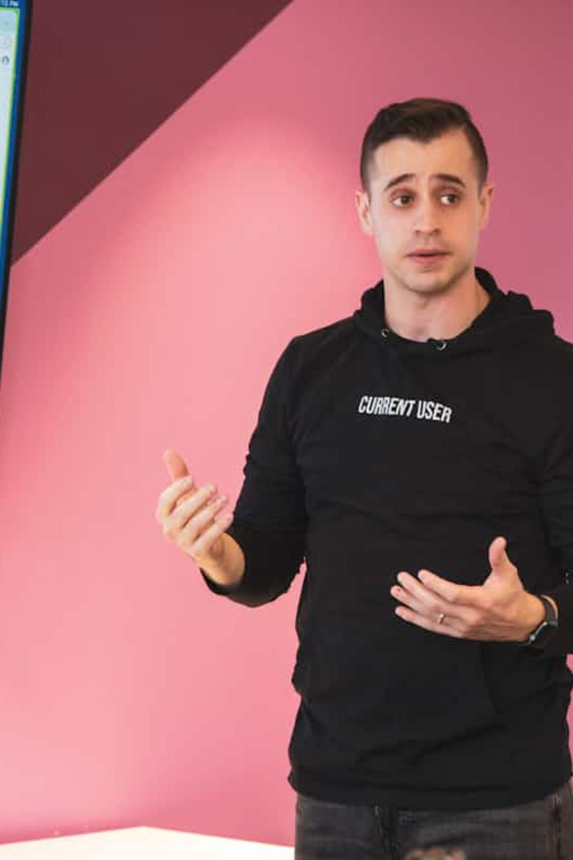
YouTube Video Analysis and Optimization

Slide 2
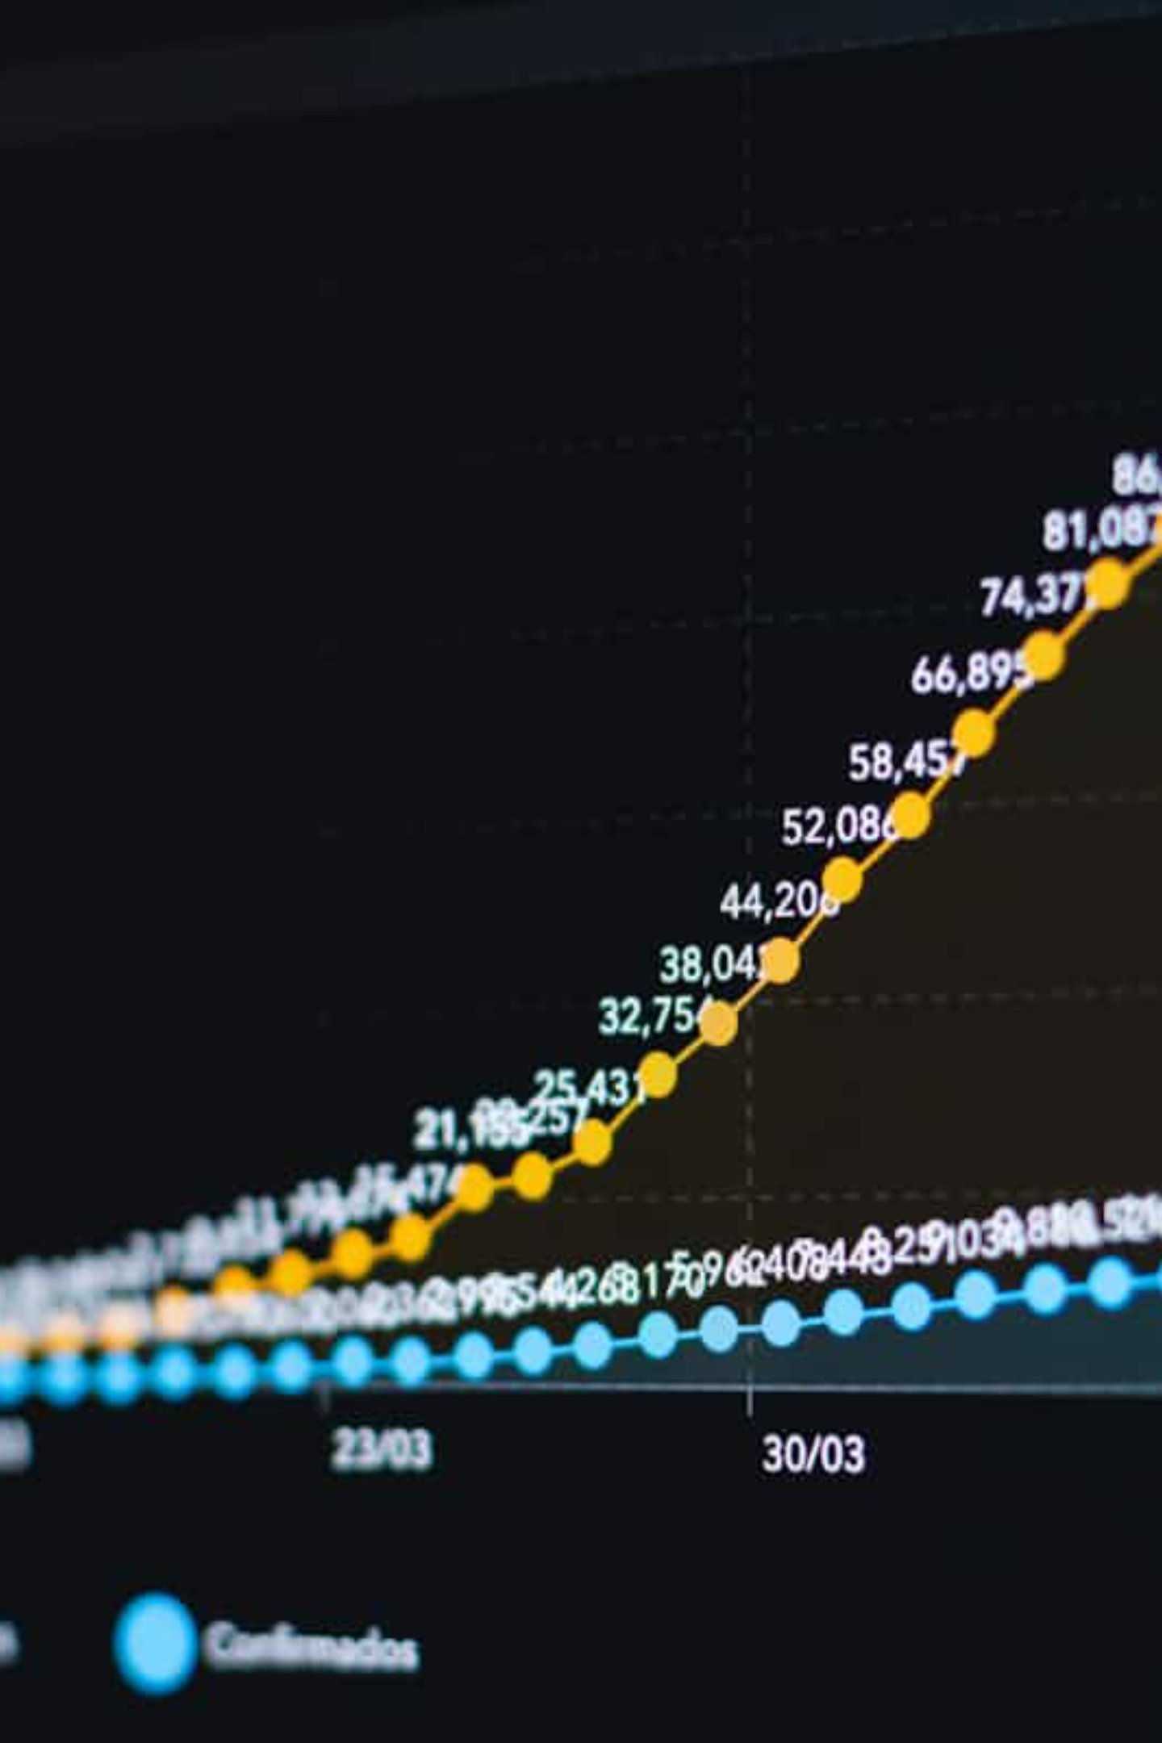



Smart Skip: Enhancing Viewer Retention
Auto-Identifies Segments
Viewer Control
Automatically identifies less engaging segments in your videos.
Enables viewers to skip ahead to the most valuable content.
Increased Watch Time
Increases overall watch time and audience retention by up to 15%.

Slide 3

Comments Analysis: Unlocking Audience Insights
AI Sentiment Analysis
Uses AI to analyze viewer comments for sentiment, questions, and trends.
Understand Preferences
Helps creators understand audience preferences and pain points.
A tech channel increased subscriber interaction by 25% after tailoring content based on comment analysis.
Targeted Improvements
Enables targeted content improvements and community engagement.

Slide 4
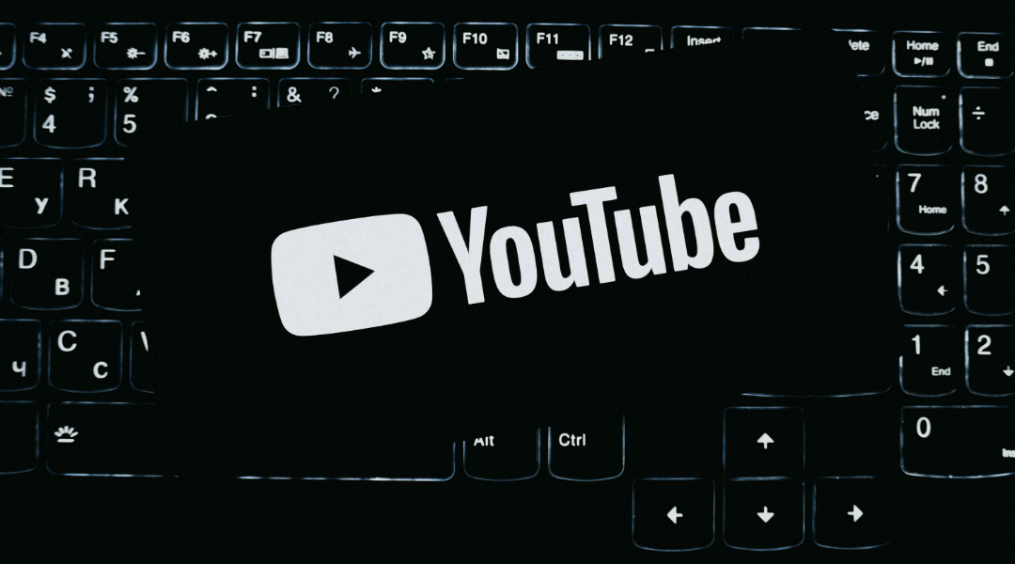

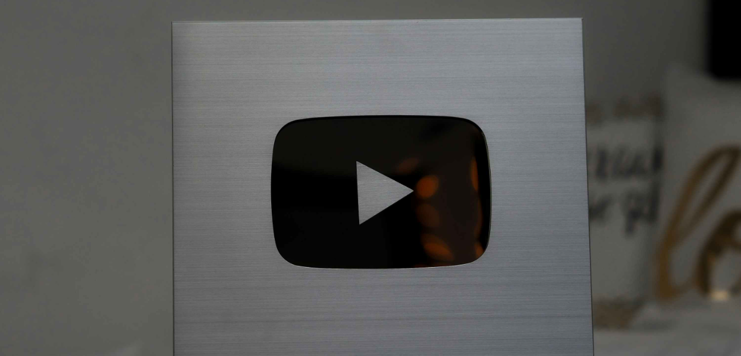
Thumbnail Analyzer & Recommendation
Boosting Click-Through Rates
Visual Element Evaluation
Data-Driven Suggestions
Up to 30% CTR Increase
Evaluates color contrast, facial expressions, and text clarity.
Provides suggestions to create eye-catching thumbnails that attract clicks.
A/B testing thumbnails can increase Click-Through Rate by up to 30%.

Slide 5


Pre-upload Recommendations: Setting Videos Up for Success
Metadata Optimization
Analyzes title, description, and tags for SEO improvements.
Optimal Video Structure
Recommends optimal video length, keywords, and category placement.
Compliance Check
Ensures compliance with YouTube Community Guidelines.
Creators following these tips see faster ranking and more immediate views.

Slide 6

Why Analyze and Optimize YouTube Videos?
Algorithm Priority
Higher Visibility
YouTube’s algorithm prioritizes watch time, CTR, and engagement.
Data-driven optimization leads to higher visibility and subscriber growth.
Continuous Improvement
Continuous improvement based on analytics outperforms guesswork.

Slide 7








Key Metrics to Track for Optimization
Watch Time
Audience Retention
Total minutes viewers spend watching your videos.
Percentage of video watched before viewers drop off.
Engagement
Click-Through Rate (CTR)
Likes, comments, shares indicating viewer interaction.
Percentage of impressions that convert to views.

Slide 8

Integrating Tools for Maximum Impact
Comments Analysis
Smart Skip
Refines pacing using viewer behavior insights.
Identifies topics to inform Smart Skip edits.
Thumbnail Analyzer
Pre-upload Recommendations
Optimizes visuals guided by engagement signals.
Applies SEO tips influenced by thumbnails and comments.
Content Refinement
Combine Smart Skip with Comments Analysis to refine content pacing and topics.
Visual & SEO Appeal
Use Thumbnail Analyzer alongside Pre-upload Recommendations for SEO and visual appeal.
Adaptive Strategy
Regularly review analytics to adapt strategies and maintain growth momentum.

Slide 9
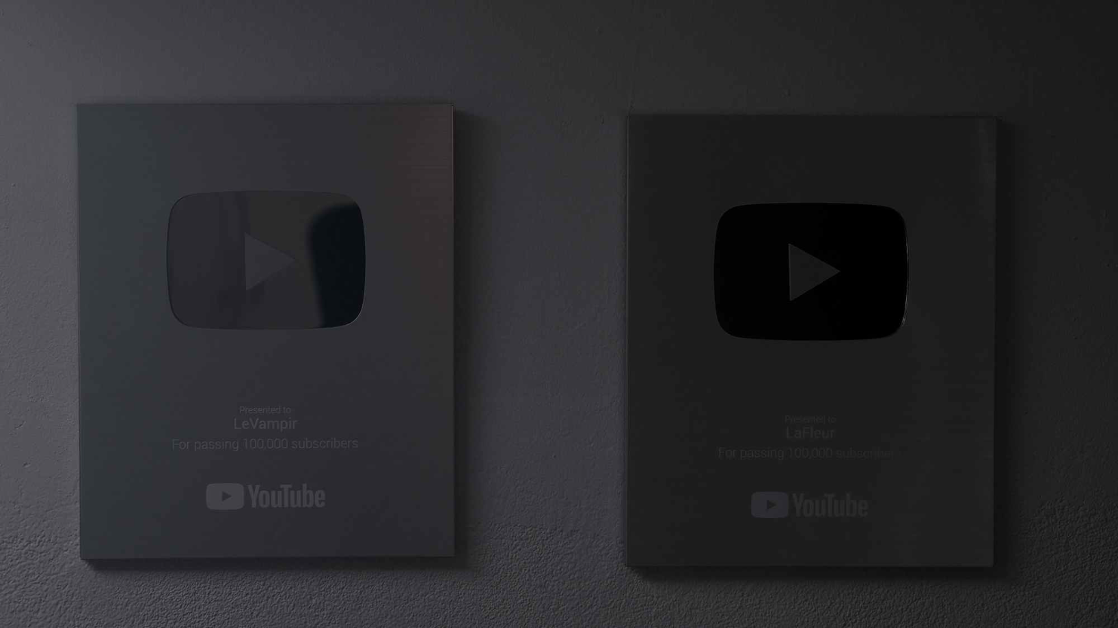
Clean, Clear, Consistent Branding Matters
Simple & Recognizable
Maintain a simple, recognizable style across thumbnails and video intros.
Consistent Aesthetics
Use consistent color palettes and fonts to build channel identity.
Boost Loyalty
Clear branding helps viewers instantly recognize your content, boosting loyalty and repeat viewership.

Slide 10

Thank You!
Ready to optimize your YouTube videos for growth and engagement?
Questions or next steps? Let’s connect and elevate your channel’s performance!

